Slide 1

County to County Flow of Youth Involved
in Child Welfare in the Bay Area
2012 to 2016

Slide 2

Trauma Transformed: County to County Population Flow Analysis
Changes in California Total Caseload
Trends in total caseload in the California decreased significantly from 2006 to 2012.
Since 2012, however, caseloads statewide have increased slightly, although recent years have a flat trend.

Slide 3
Trauma Transformed: County to County Population Flow Analysis
Changes in Total Caseload
When the Bay Area counties are broken out separately from the rest of the state their basic trend appears different than the rest of the state, much flatter and more stable.
However, when you control for the size of these two areas, you see that in the Bay Area caseloads decreased faster from 2006 to 2012 and have increased more slowly since 2012.

Slide 4
Trauma Transformed: County to County Population Flow Analysis
Changes in Total Caseload
Trends in total Bay Area caseload seem to have significantly changed direction in 2012. Prior to that time total caseloads were decreasing, since that time caseloads have begun to moderately increase.
Given that significant change in total caseload trend it seemed that looking at change over the last four years of data (2012 to 2016) would provide the most relevant insights.

Slide 5
Trauma Transformed: County to County Population Flow Analysis
Definition of Terms:
Talking about the flow of populations from one geography to another can be confusing. Defining terms can help make these changes in dynamics clearer.
County caseload has the following parts:
Start Caseload:
  Those child welfare cases that originate in a given county.
County Outflow:
  Of those cases that originate in a given county the number that end up placed outside of their home county.
Base Caseload:
  Of those cases that originate in a given county those that stay in that county.
County Inflow:
  Of those cases that are physically placed in a given county those cases that originated outside of that county.
End Caseload:
  All of those cases, both those that originate in a county and those that came from outside the county, that currently reside within a given county
End Caseload

Slide 6
Trauma Transformed: County to County Population Flow Analysis
Definition of the Bay Area:
For this study the Bay Area is made up of seven counties:
Alameda,
Contra Costa
Marin
Santa Clara
Santa Cruz
San Francisco
San Mateo
Each county contributes a different amount to the total caseload of the bay area.
Alameda, Santa Clara & Contra Costa make up 72% of the child welfare cases in the Bay Area.

Slide 7
Trauma Transformed: County to County Population Flow Analysis
Composition of Bay Area:
Over time the proportion of the total Bay Area caseload made up by each county had changed, with counties like San Francisco becoming less of the total and counties like Santa Clara become more of the total.

Slide 8
Trauma Transformed: County to County Population Flow Analysis
Composition of Bay Area:
Accounting for the in-flow and out-flow of total cases makes a significant difference in proportional make up of the Bay Area.
Due to large out-flows some counties, like San Francisco, make up a significantly smaller proportion of the total Bay Area caseload while others, like Contra Costa, make up a significantly larger proportion.
Start Caseload
End Caseload

Slide 9
Trauma Transformed: County to County Population Flow Analysis
Change over time:
The total caseload inflow and outflow has changed over time.
About half of the counties in the Bay Area have seen the number of youth remaining in their home county stay the same while the other half have seen it decrease in recent years.
Generally, the percent of inflow youth has been decreasing. The exceptions being San Francisco and Alameda counties.

Slide 10
Trauma Transformed: County to County Population Flow Analysis
Definition of Terms:
In the end, there are two types of counties:
Net Gain County:
  Those counties where base caseload plus county inflow equal more than base caseload plus county outflow.
Net Loss County:
  Those counties where base caseload plus county inflow equal less than base caseload plus county outflow.
In other words, when all of the county flows are accounted for some counties end up with more youth than they would have had if no youth had entered or exited and other with less.

Slide 11
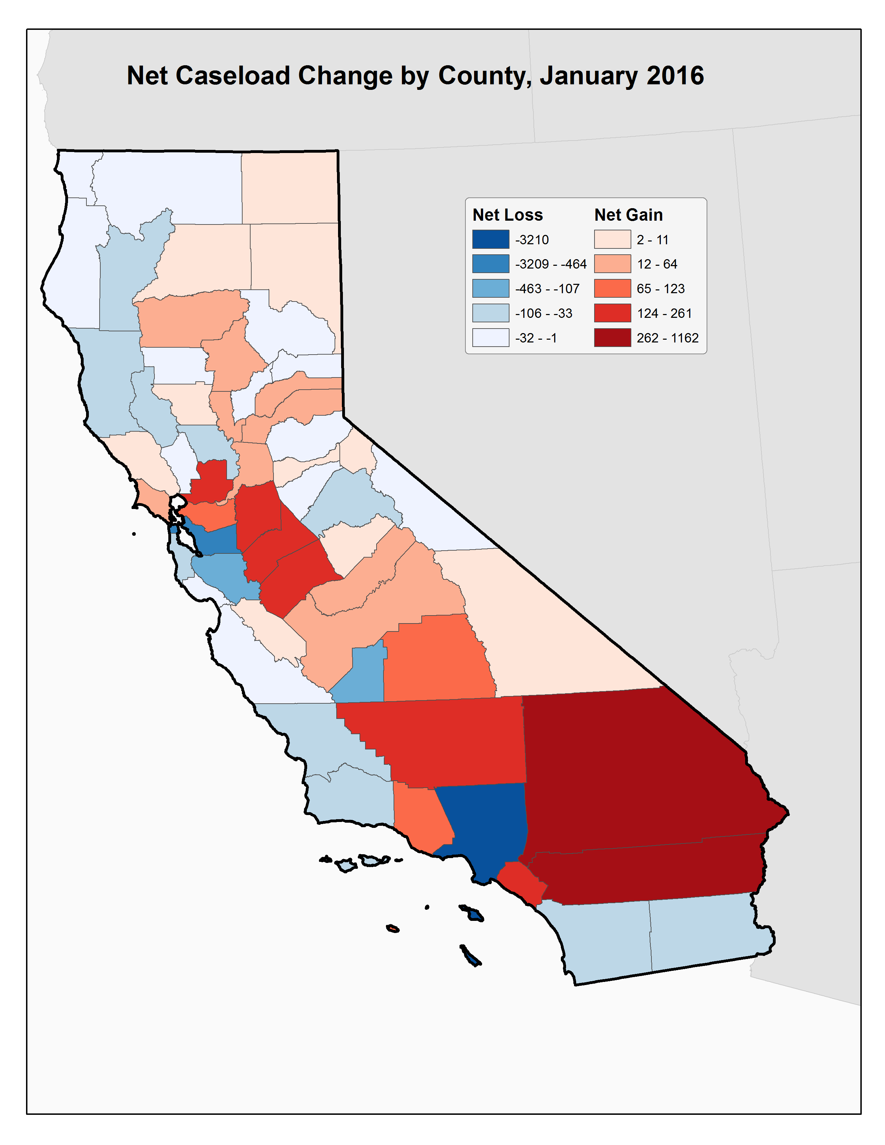
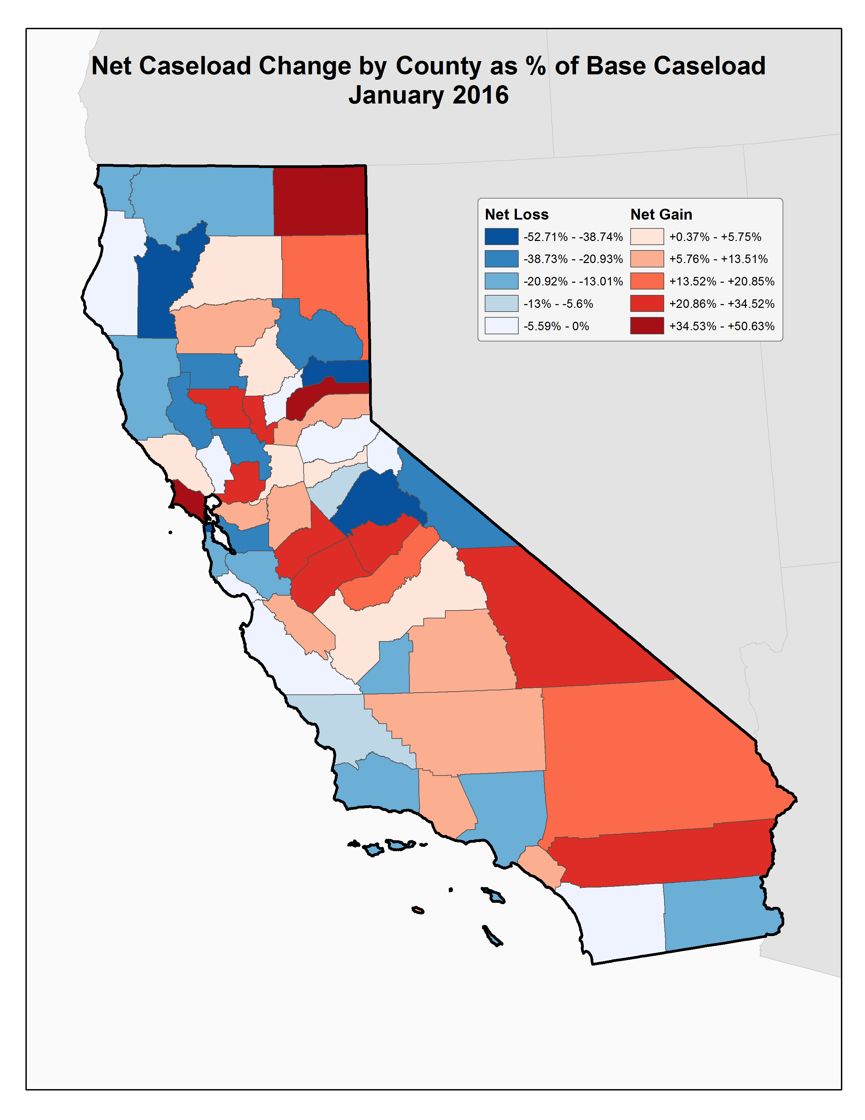
Trauma Transformed: County to County Population Flow Analysis

Slide 12
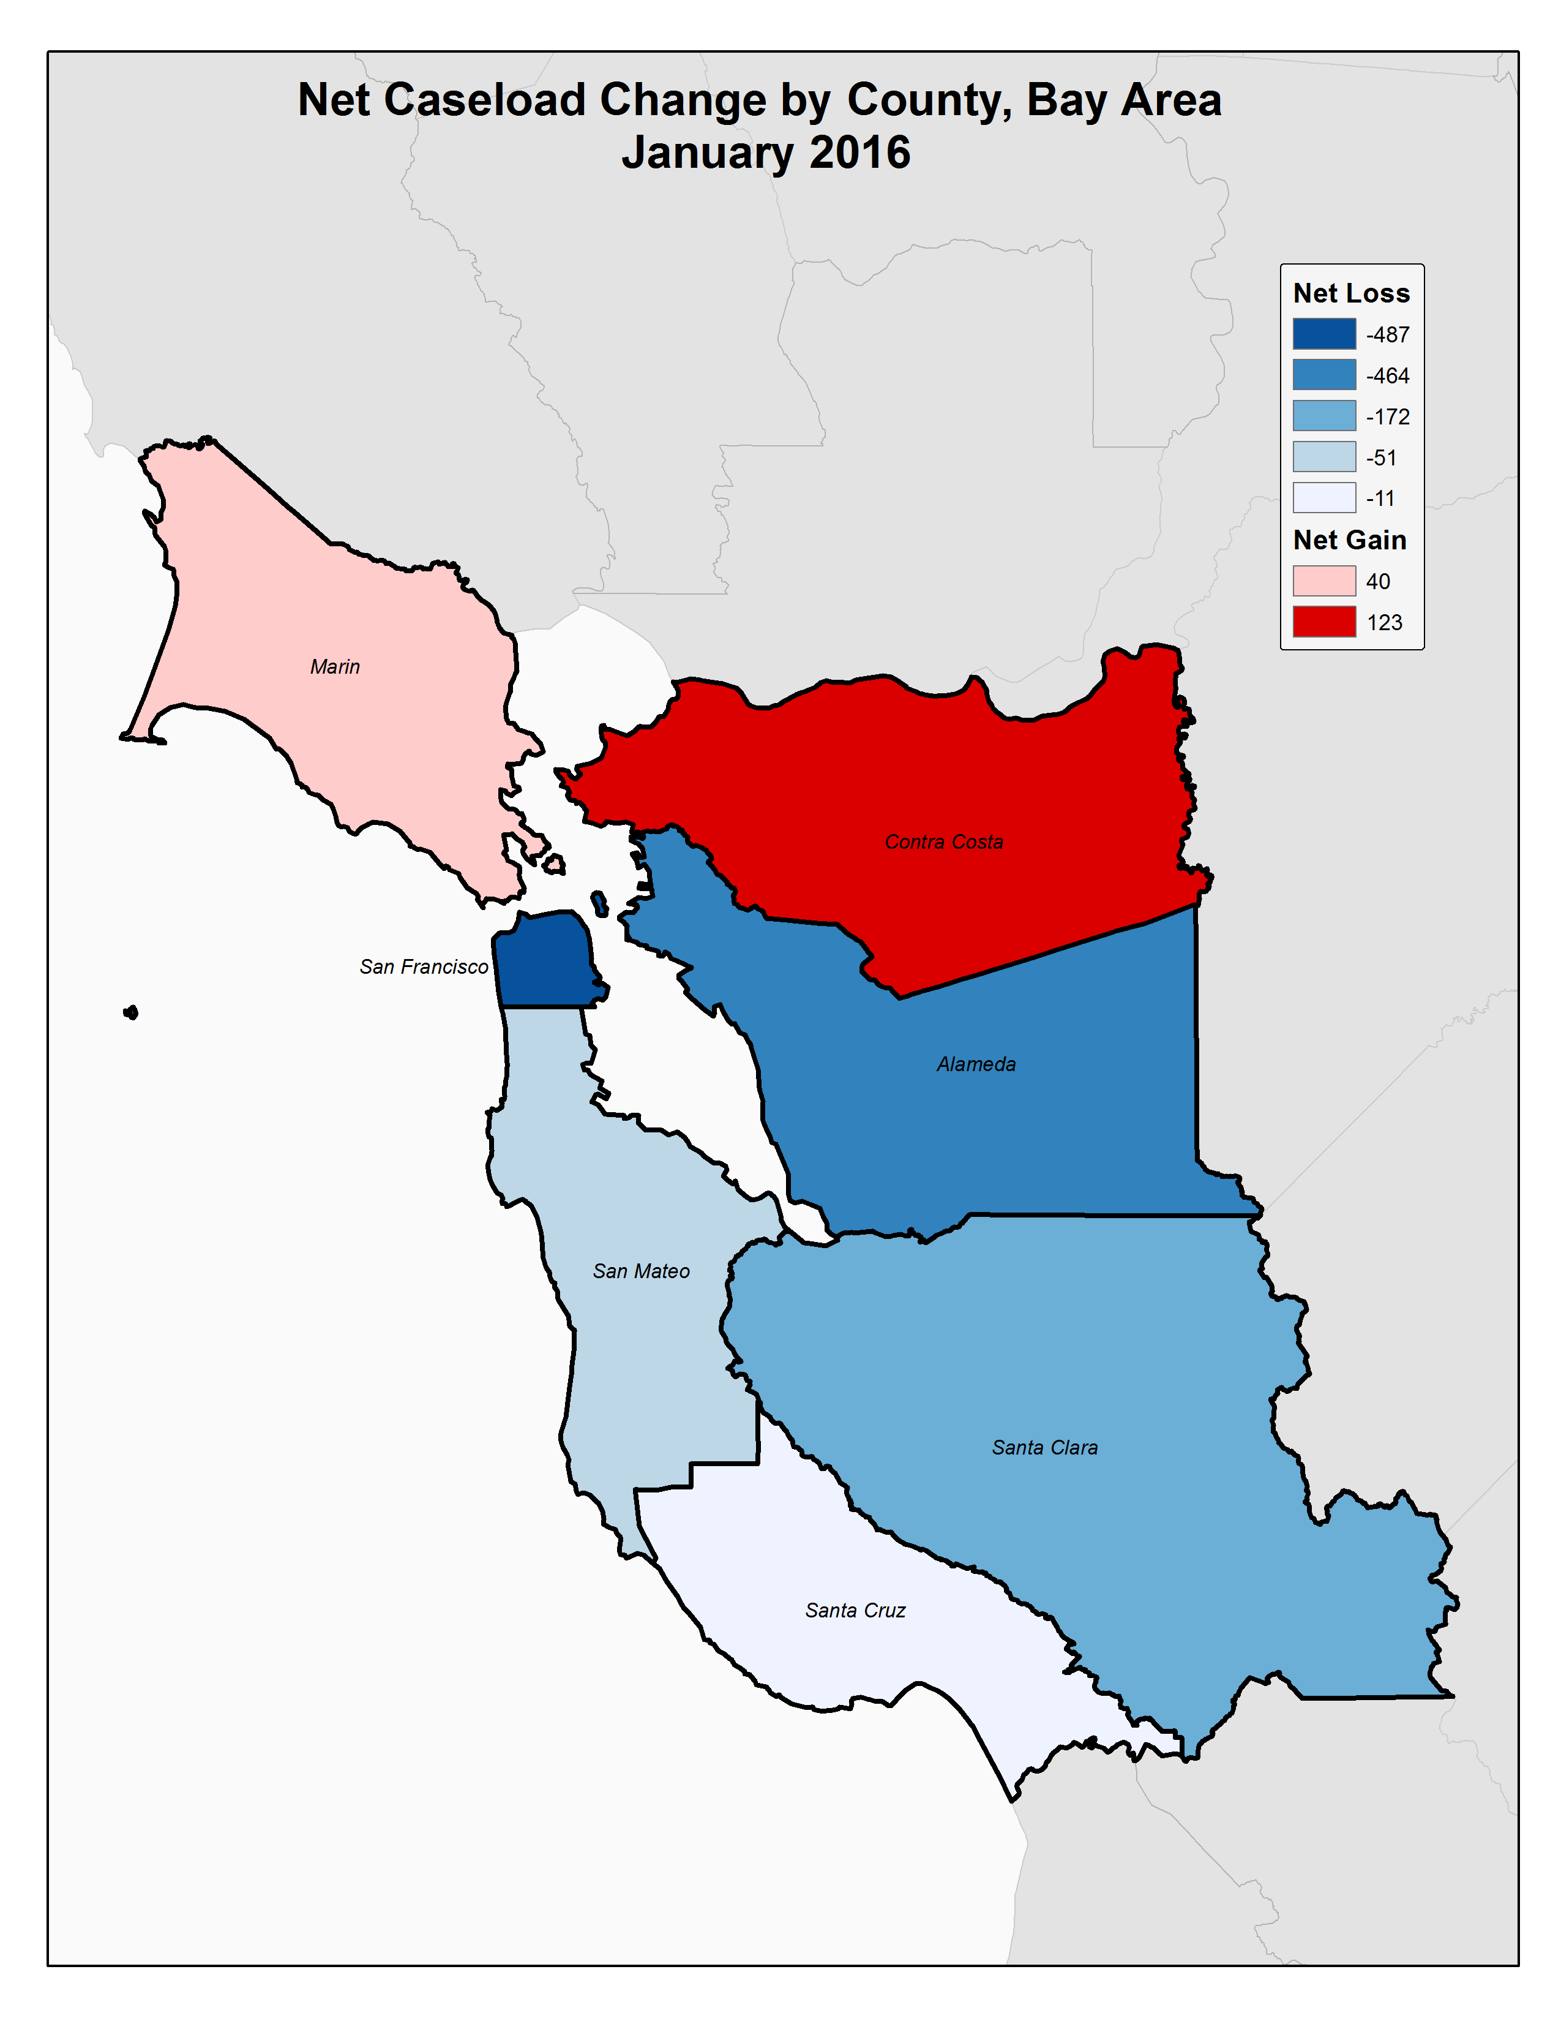
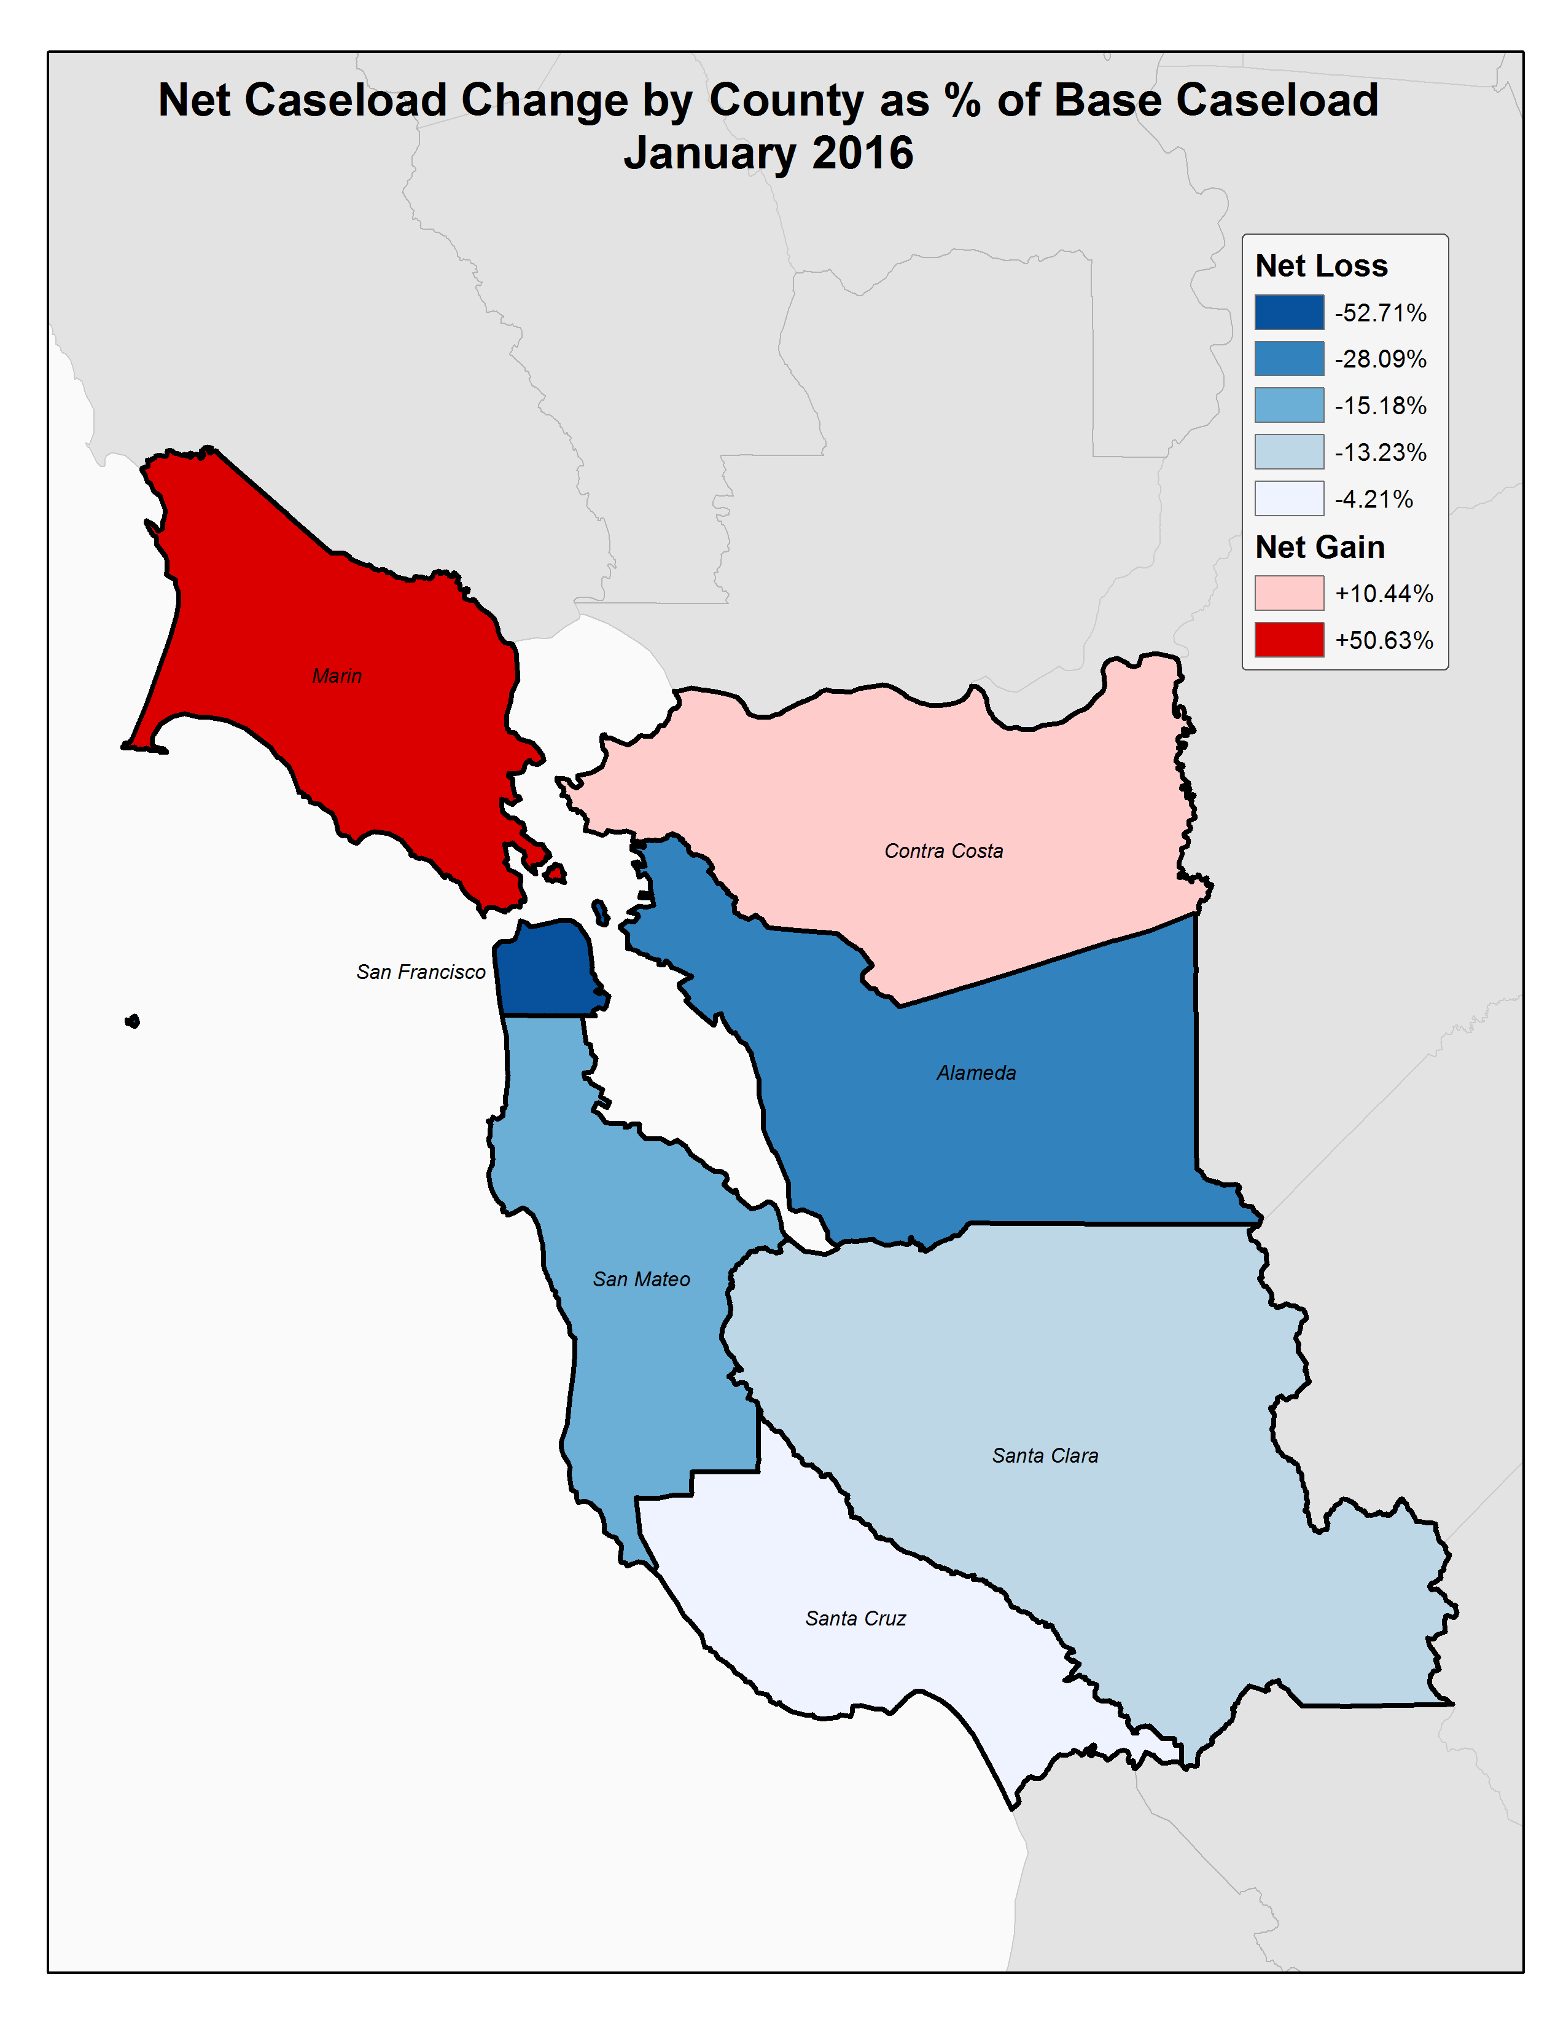
Trauma Transformed: County to County Population Flow Analysis

Slide 13
Trauma Transformed: County to County Population Flow Analysis
Composition of Alameda County:
From 2013 to 2014 Alameda County saw an increase in total caseload. Since 2014 caseloads, with some variation, have remained largely the same.

Slide 14
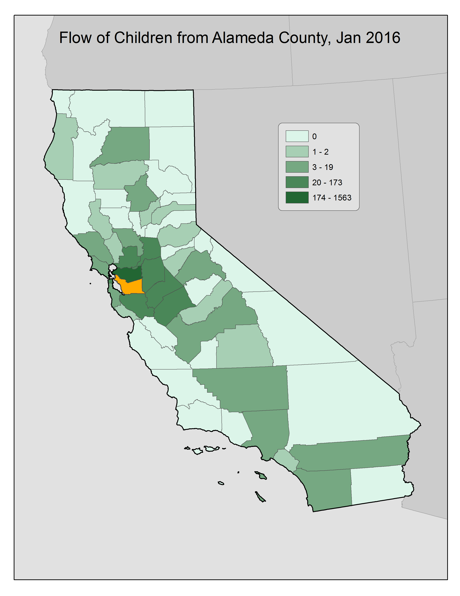
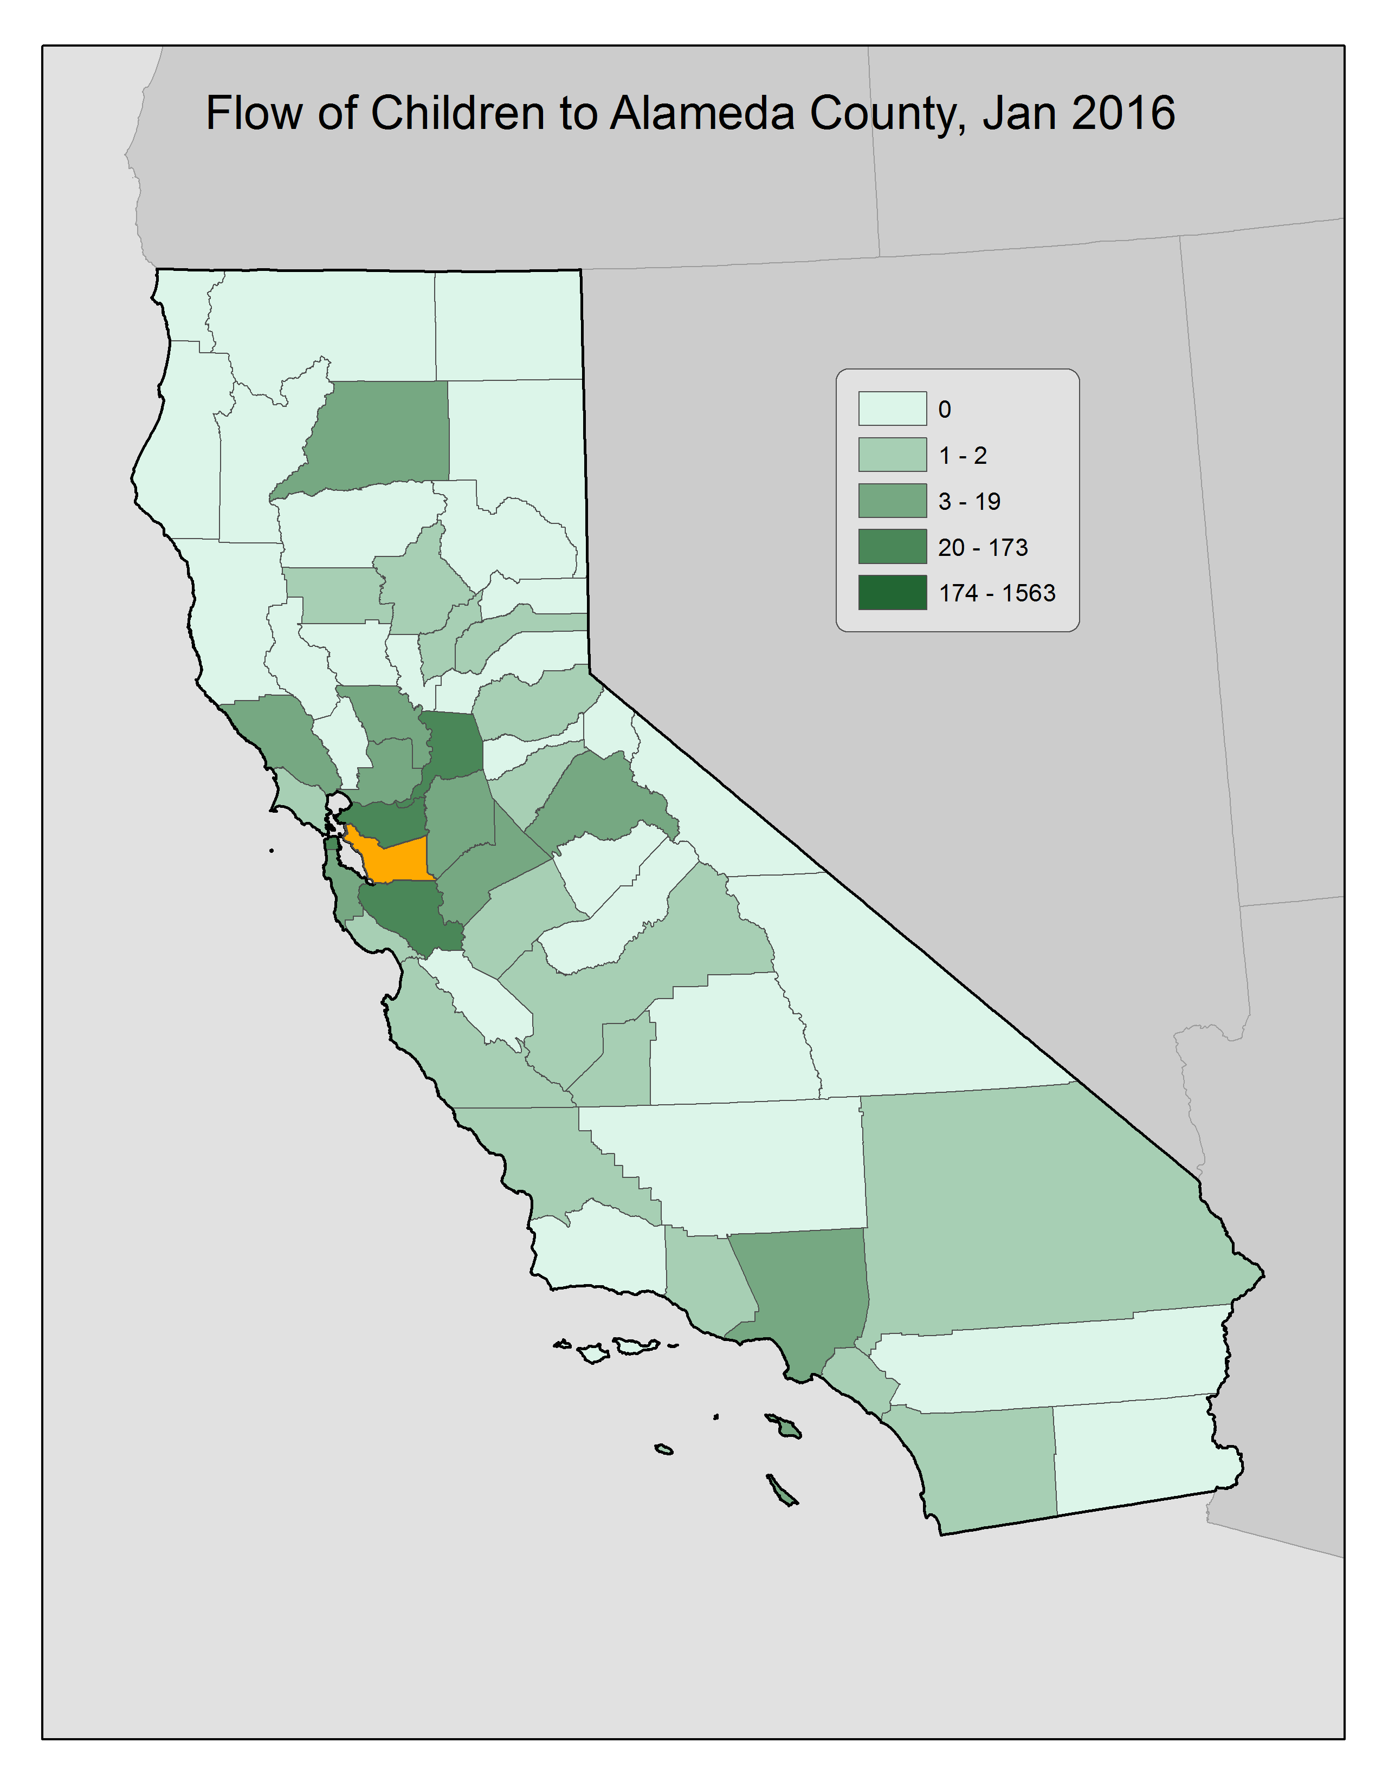

Slide 15
Alameda County Outflow

Slide 16
Alameda County Inflow

Slide 17
Trauma Transformed: County to County Population Flow Analysis
Conclusion:
Movement across counties is significant
Movement of youth involved in the Child Welfare system in the Bay Area is significant and higher than the remainder of the state.
At 39% the proportion of youth placed outside of their county of origin in the Bay Area is almost double the rate of 19% for the rest of the state.
The number of youth residing in a county other then their home county has increased 6% in the last four years

Slide 18
Trauma Transformed: County to County Population Flow Analysis
Conclusion:
Youth placed outside Bay Area is increasing
Of those youth residing outside of their home county in January of 2016 62% are placed outside of the seven county Bay Area.
Over the last four years the total number of youth who have been placed outside of the Bay Area has increased 30%

Slide 19
Trauma Transformed: County to County Population Flow Analysis
Conclusion:
There is a lot of population turbulence.
The number of youth entering and exiting a given county in the Bay Area is often equal to or greater than those who stay in their county of origin.
After a decrease in population turbulence recent data indicates that it is increasing.

Slide 20

Trauma Transformed: County to County Population Flow Analysis
Further Questions:
What proportion of youth placed outside of their home county are relative placements?
What proportion of moves across county lines are actually small moves?
What impact do multiple moves have on this analysis?

Slide 21
Mike Stiehl
Senior Policy Analyst
Chapin Hall at the University of Chicago
1313 East 60th Street
Chicago, IL 60637
Phone: 773-882-0296
E-Mail: mstiehl@chapinhall.org
www.chapinhall.org

Slide 22
Trauma Transformed: County to County Population Flow Analysis
Composition of Contra Costa County:
[Insert updated text about Contra Costa County 2012-2016 here]
Max 882, Jan 2015
Min: 708, Jan 2012

Slide 23
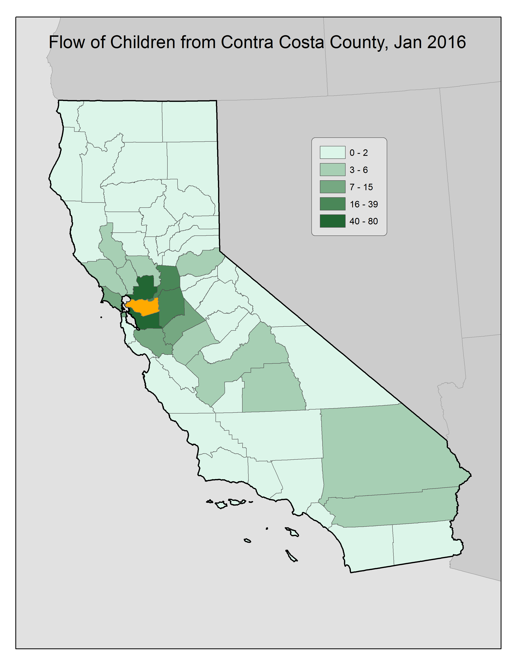
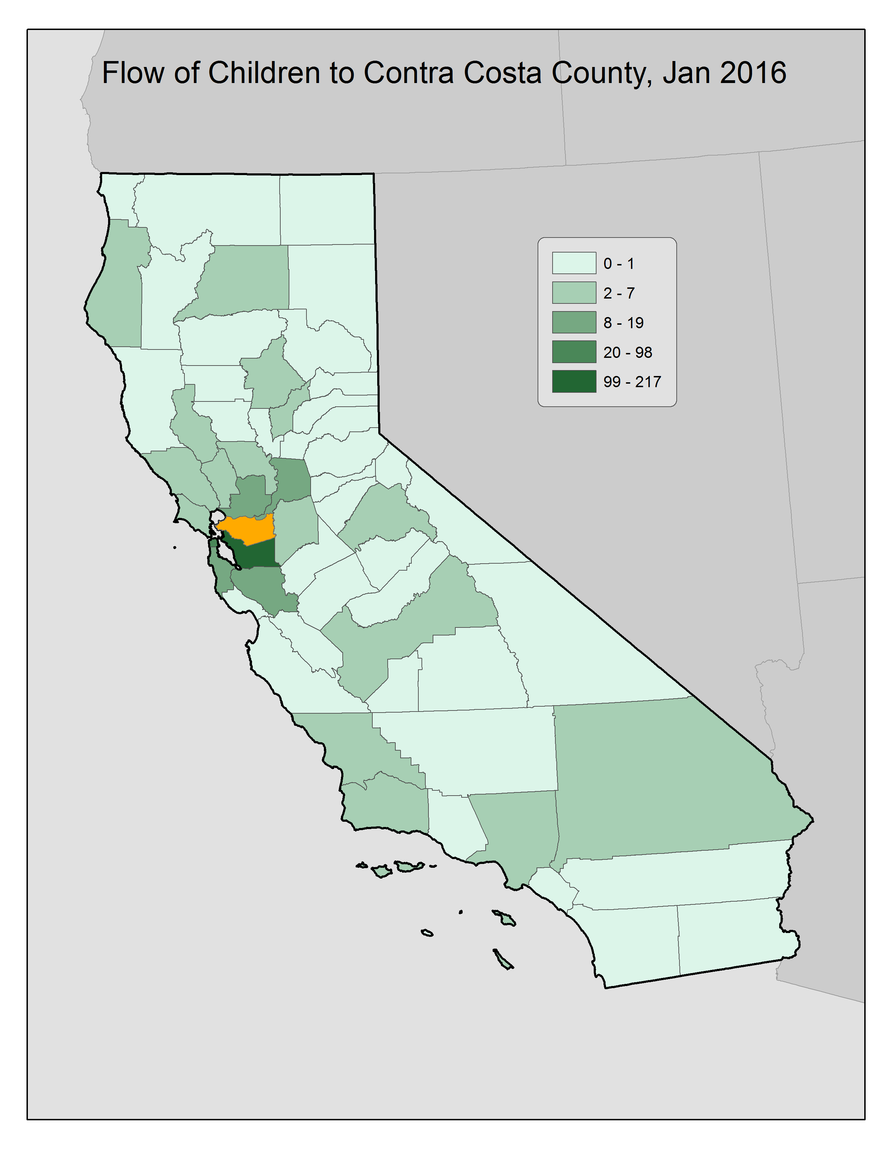

Slide 24
Contra Costa County Outflow

Slide 25
Contra Costa County Inflow

Slide 26
Trauma Transformed: County to County Population Flow Analysis
Composition of Marin County:
Total caseload in Marin County has, with some variation, been decreasing since a peak in 2012.
Max 133, Jul 2012
Min: 119, Jan 2016

Slide 27
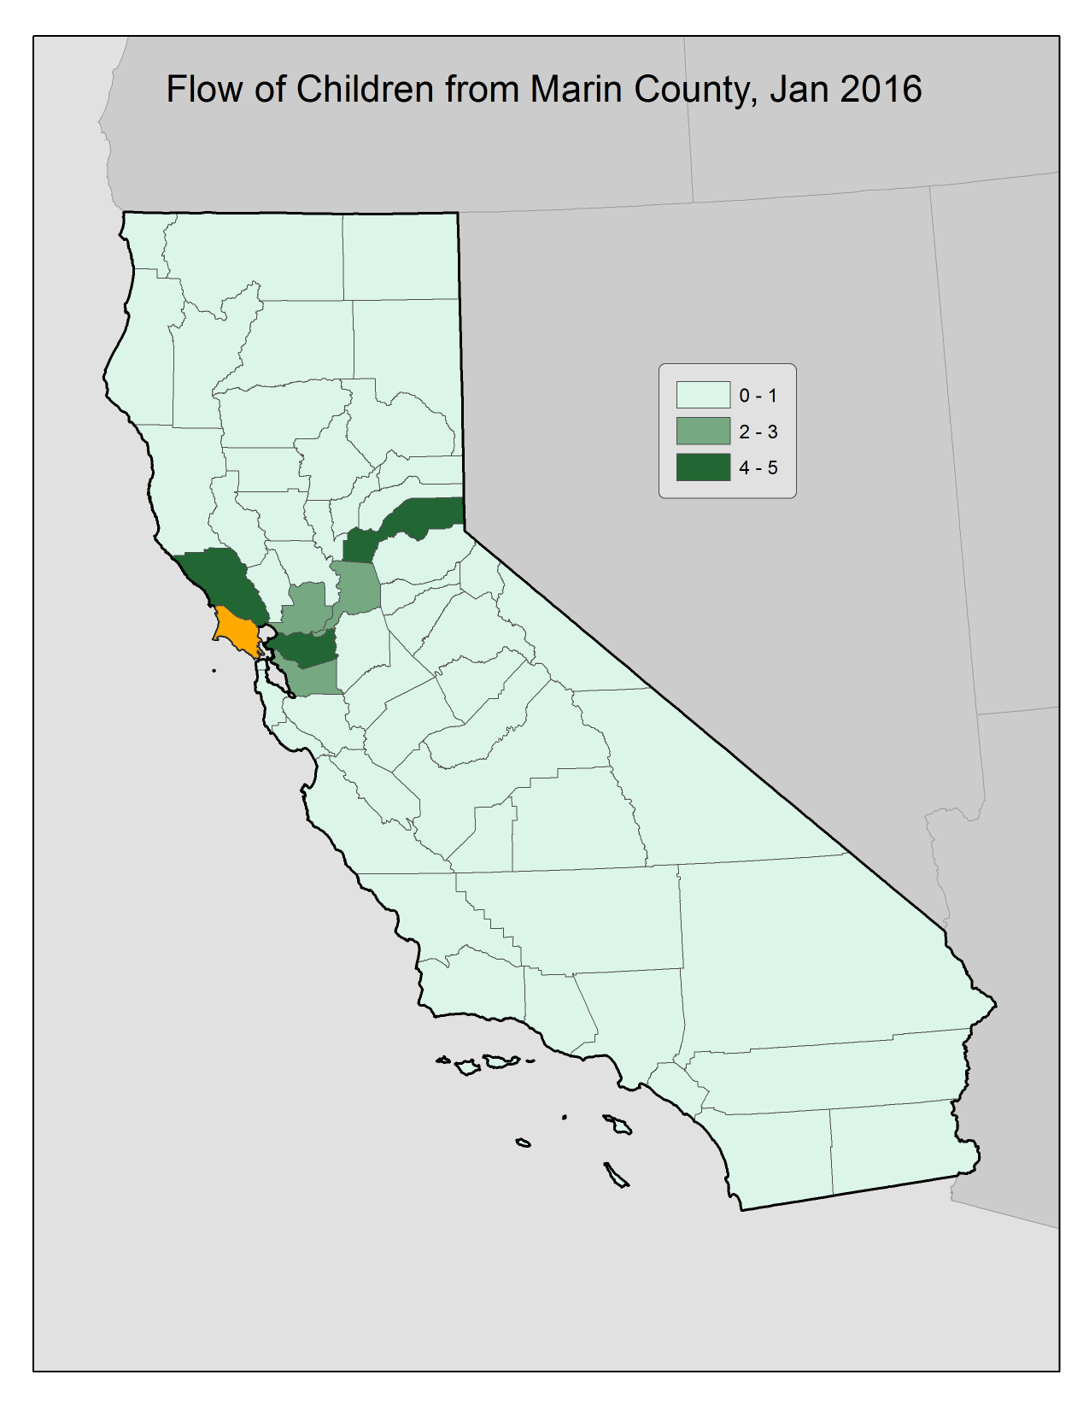
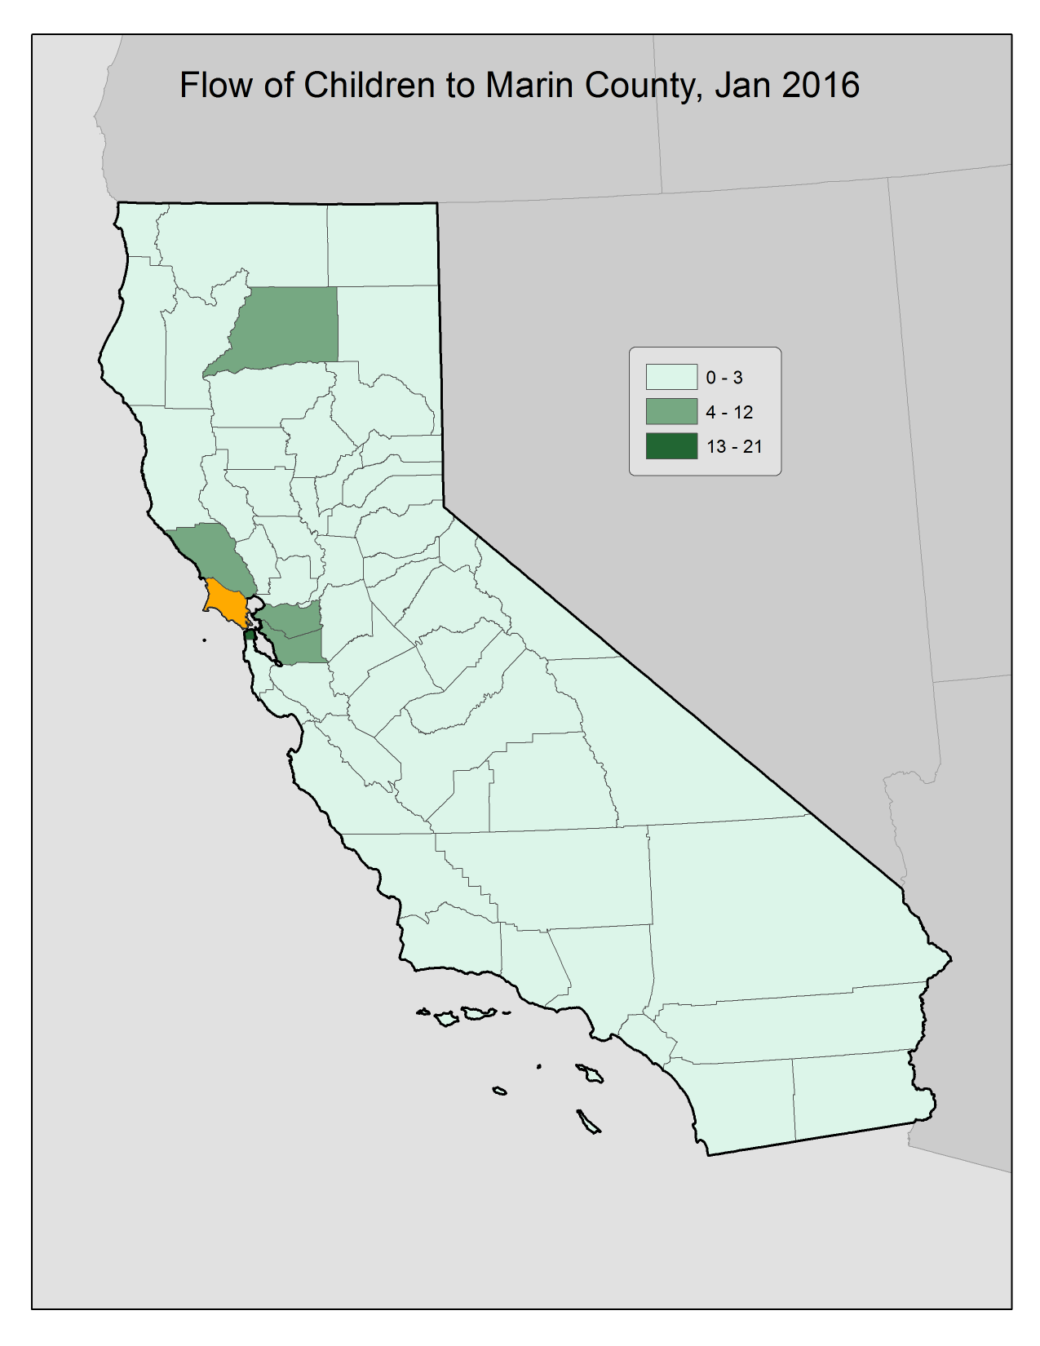

Slide 28
Marin County Outflow

Slide 29
Marin County Inflow

Slide 30
Trauma Transformed: County to County Population Flow Analysis
Composition of Santa Clara County:
Santa Clara County experienced growth in total caseload from 2012 until the beginning of 2015.
Since January of 2015, however, total caseloads seem to be decreasing.
Max: 1218, Jan 2015
Min 901, Jan 2012

Slide 31
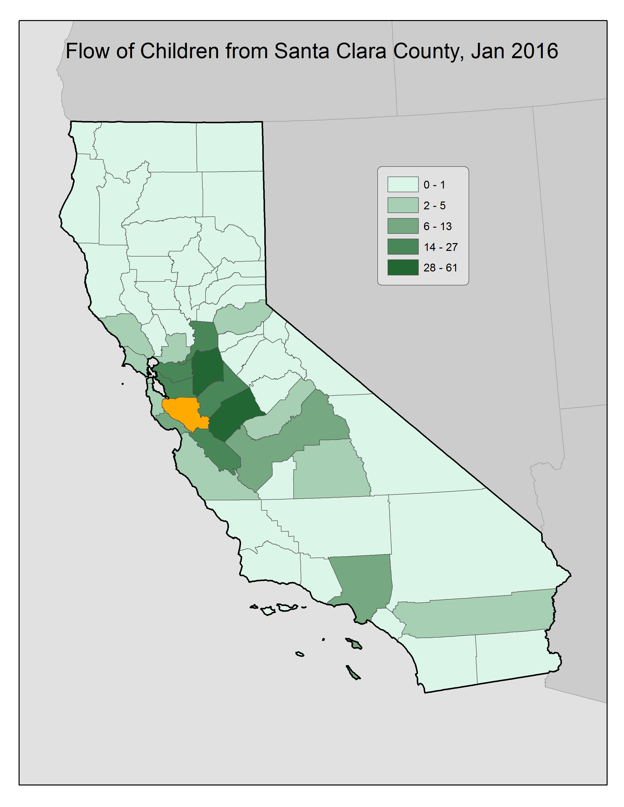
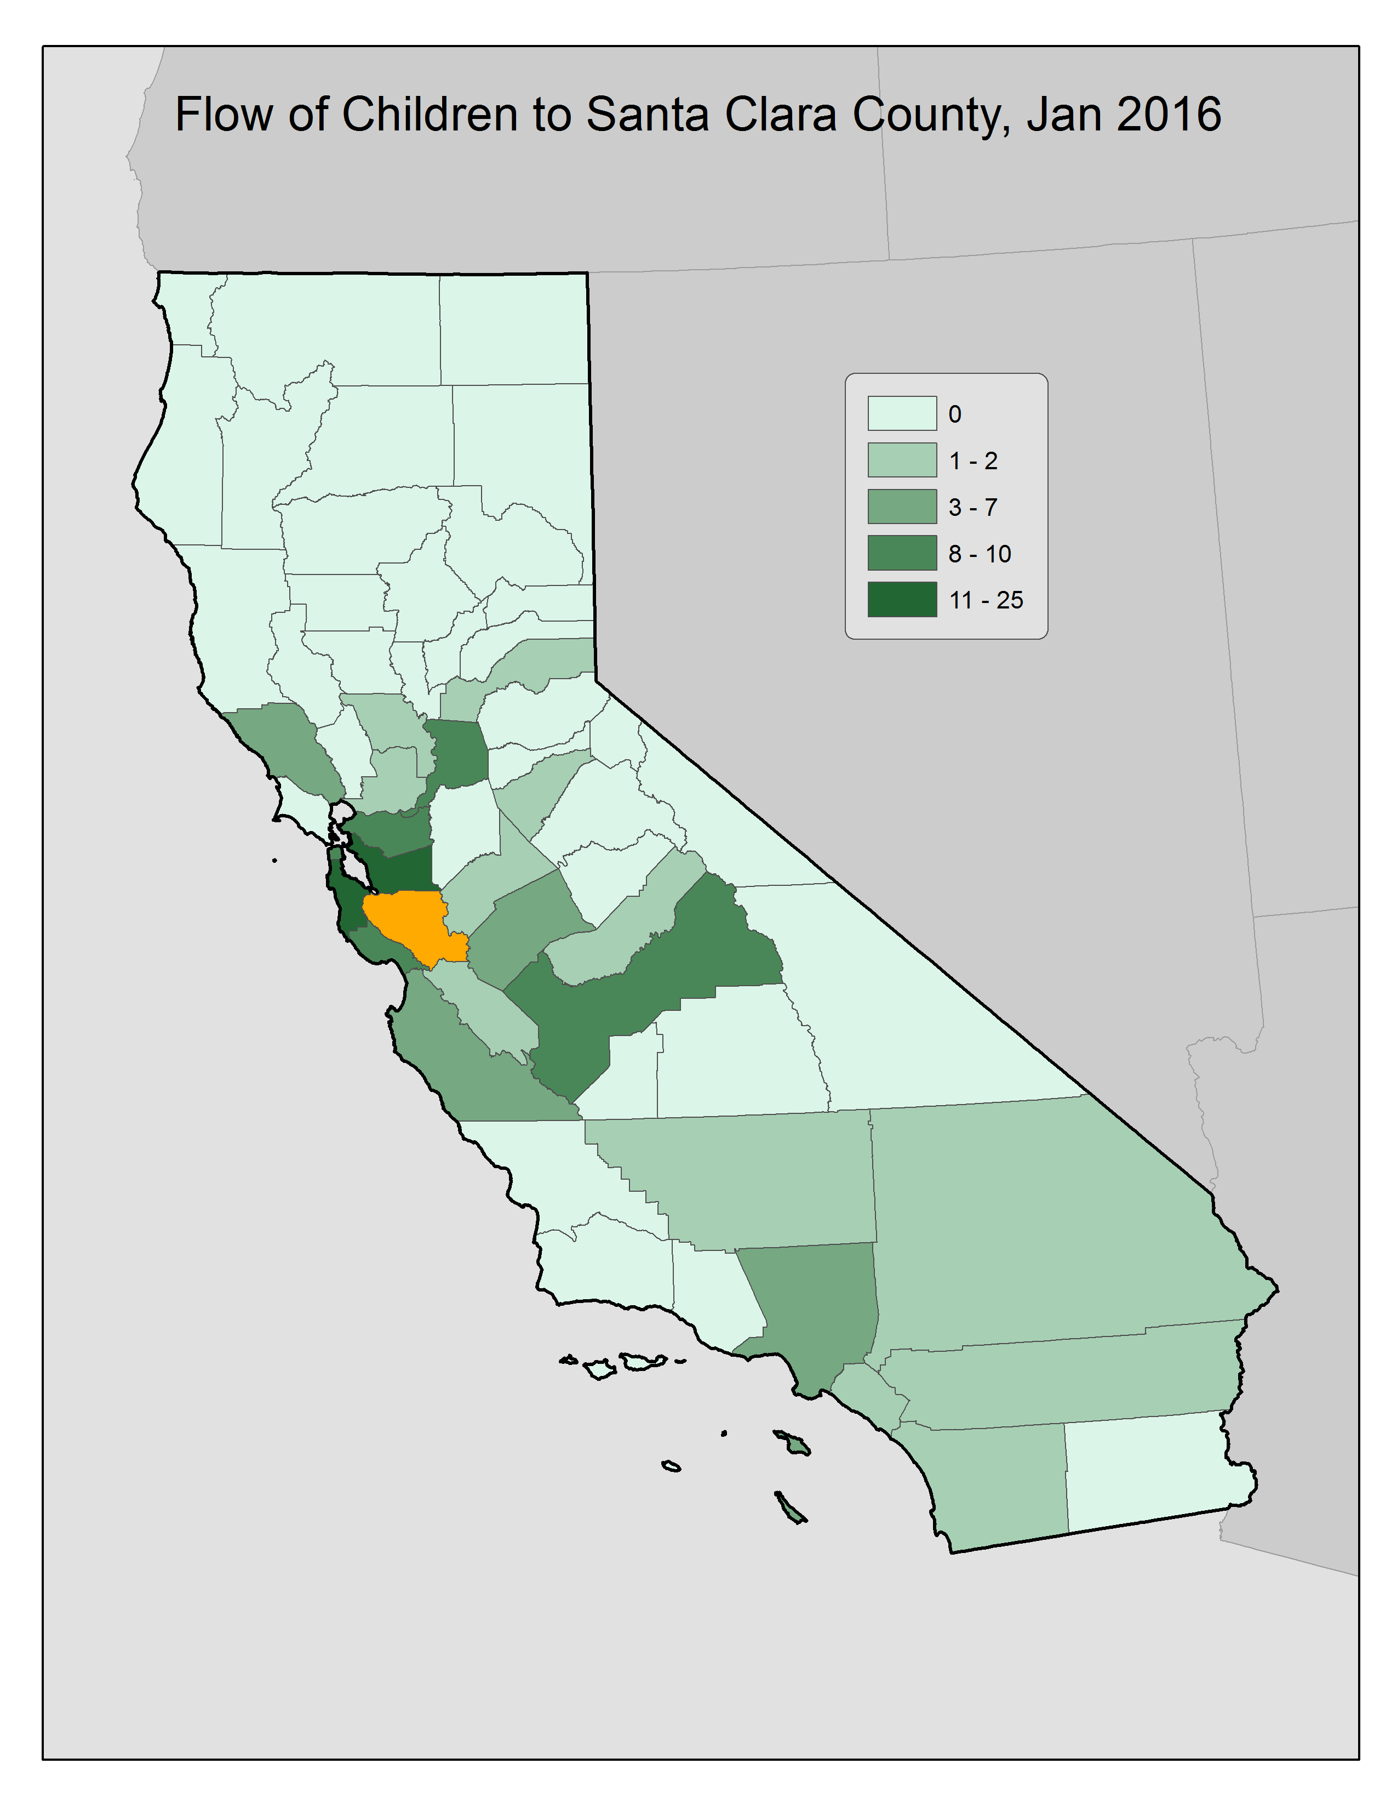

Slide 32
Santa Clara County Outflow

Slide 33
Santa Clara County Inflow

Slide 34
Trauma Transformed: County to County Population Flow Analysis
Composition of Santa Cruz County:
Despite a swing in 2013, total caseload in Santa Cruz county has been largely stable, or slightly downward trending, since 2012.
Max: 286, Jan 2013
Min 246, Jan 2014

Slide 35
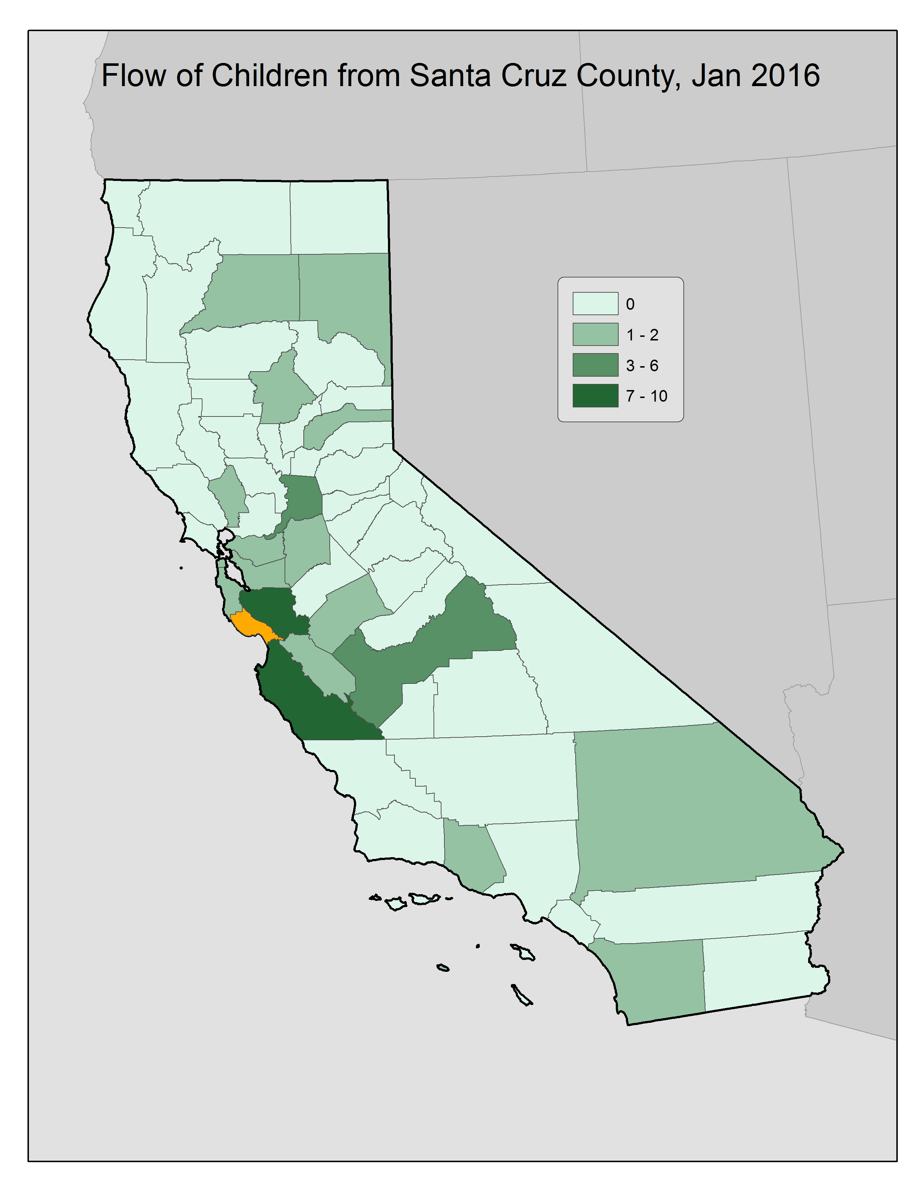
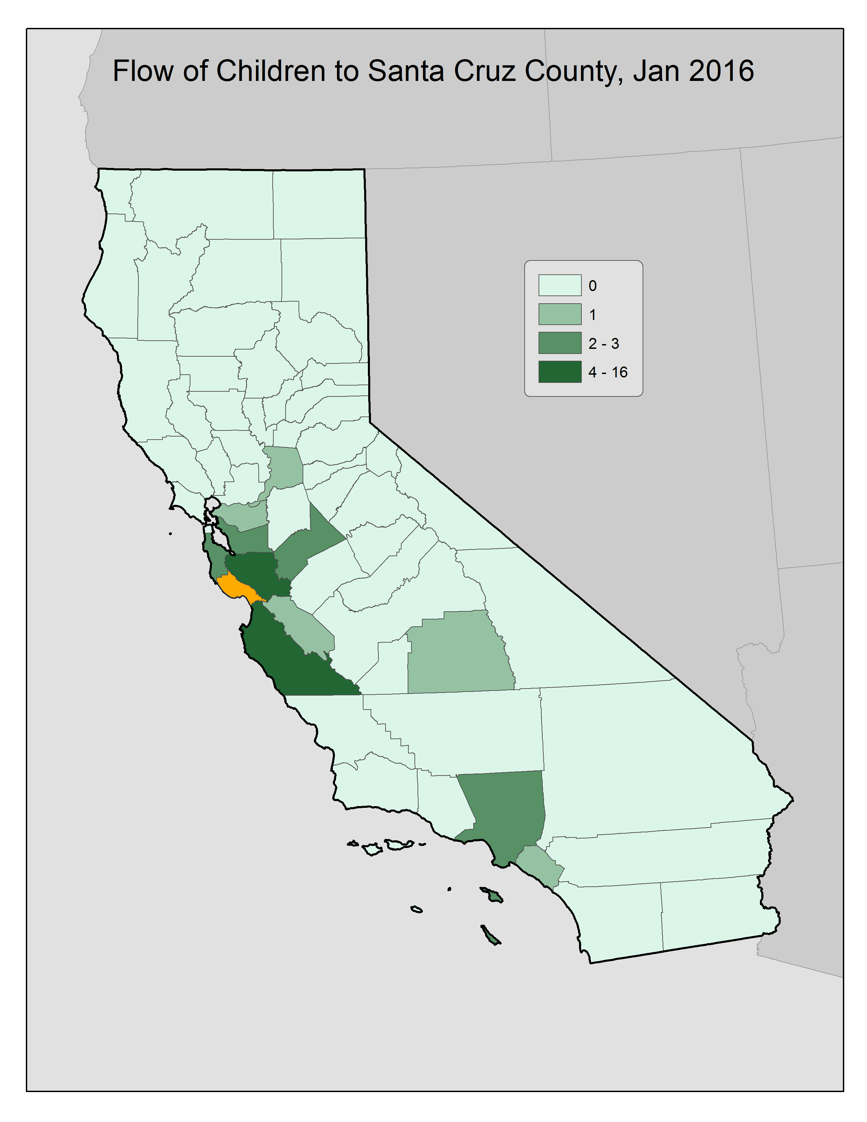

Slide 36
Santa Cruz County Outflow

Slide 37
Santa Cruz County Inflow

Slide 38
Trauma Transformed: County to County Population Flow Analysis
Composition of San Francisco County:
Total caseloads in San Francisco have been decreasing since 2012.
Max: 531, Jan 2013
Min 437, Jan 2016

Slide 39
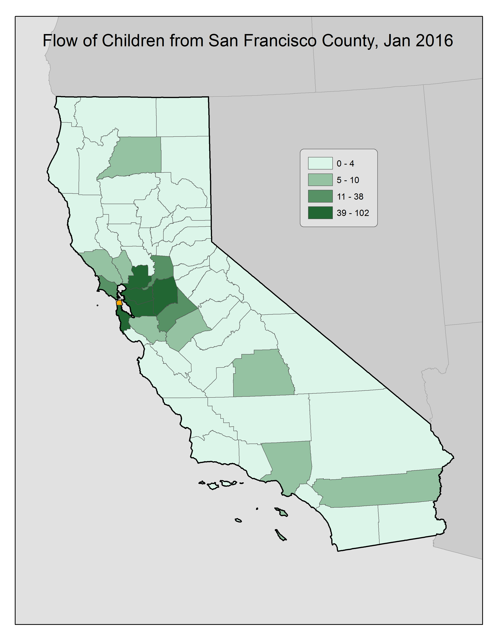
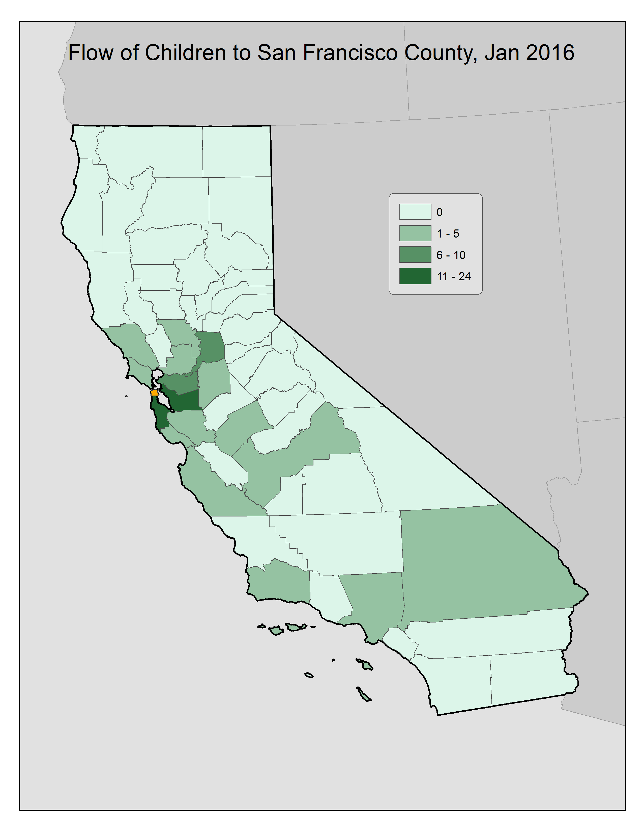

Slide 40
San Francisco County Outflow

Slide 41
San Francisco County Inflow

Slide 42
Trauma Transformed: County to County Population Flow Analysis
Composition of San Mateo County:
San Mateo County saw an increase in total caseload from 2012 to 2013.
Since the end of 2013, however, total caseloads have decreased significantly.
Max: 352, Jul 2013
Min 285, Jan 2016

Slide 43
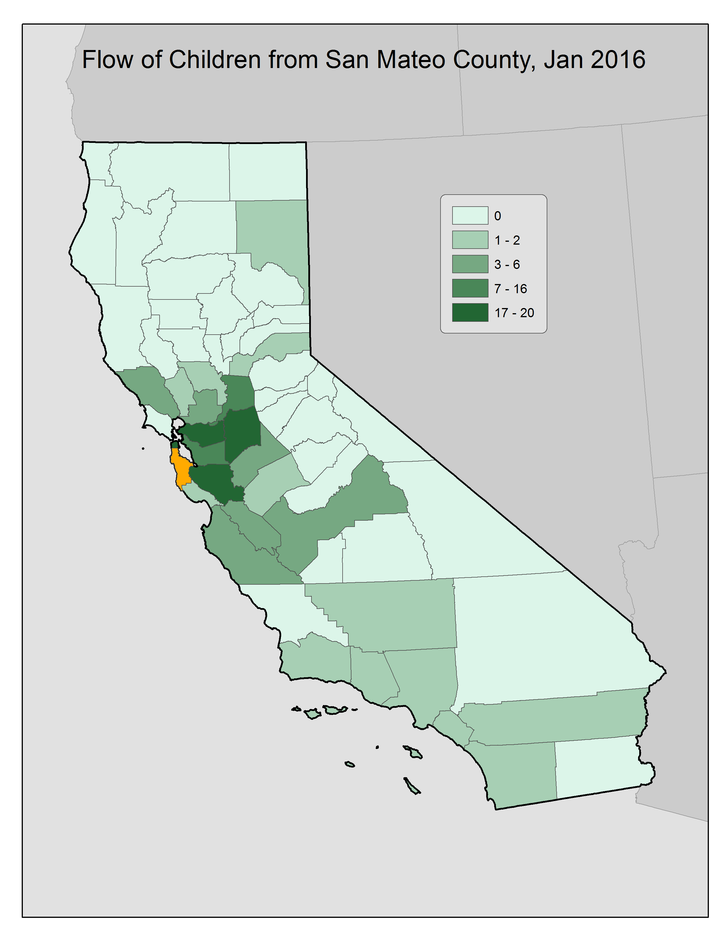


Slide 44
San Mateo County Outflow

Slide 45
San Mateo County Inflow

Slide 46
Mike Stiehl
Senior Policy Analyst
Chapin Hall at the University of Chicago
1313 East 60th Street
Chicago, IL 60637
Phone: 773-882-0296
E-Mail: mstiehl@chapinhall.org
www.chapinhall.org

